Slide 1

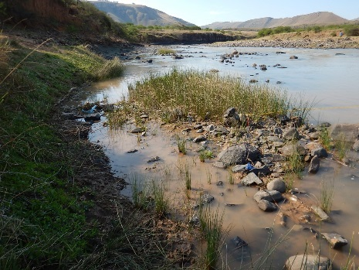

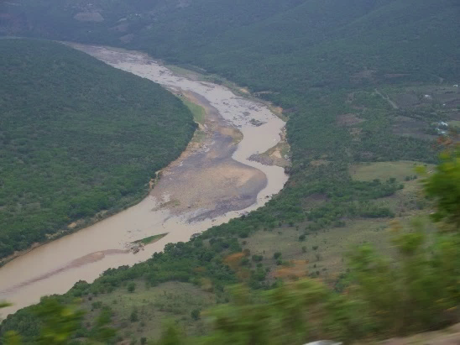
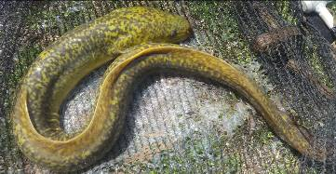
WP 11004: PSC MEETING 3,
13 February 2018
PRESENTATION TITLE
Presented by:
Name Surname
Directorate
Date
DETERMINATION OF WATER RESOURCE CLASSES AND RESOURCE QUALITY OBJECTIVES FOR THE WATER RESOURCES IN THE MZIMVUBU CATCHMENT:
FINAL RANKING OF SCENARIOS AND RECOMMENDATIONS
Colin Talanda

Slide 2
PROJECT PLAN

Slide 3
VISUALISATION OF VARIABLE SCORES

Slide 4
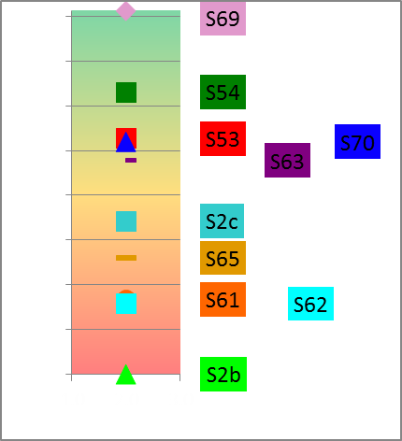
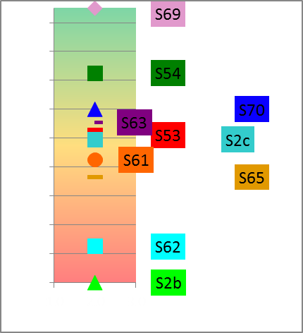
OVERALL RANKING
(TWO RANK METHODS)
Normalised
Ranking Method
Rank Order
Ranking Method

Slide 5
SENSITIVITY ANALYSIS AND SYNTHESIS OF RESULTS
Weights |  |  |  |  |  | Rank Position of Scenario (Normalisation Ranking Method)
Alternative | Ecology | EcoSystem Services | GDP | Jobs |  | S2b | S53 | S54 | S61 | S62 | S63 | S65 | S69 | S2c | S70
1 | 0.50 | 0.05 | 0.20 | 0.25 |  | 10.0 | 3.0 | 2.0 | 8.0 | 9.0 | 5.0 | 7.0 | 1.0 | 6.0 | 4.0
2 | 0.50 | 0.10 | 0.20 | 0.20 |  | 10.0 | 3.0 | 2.0 | 9.0 | 8.0 | 5.0 | 6.0 | 1.0 | 7.0 | 4.0
3 | 0.50 | 0.15 | 0.15 | 0.20 |  | 10.0 | 3.0 | 2.0 | 9.0 | 7.0 | 6.0 | 5.0 | 1.0 | 8.0 | 4.0
4 | 0.50 | 0.05 | 0.15 | 0.30 |  | 10.0 | 3.0 | 2.0 | 8.0 | 9.0 | 5.0 | 7.0 | 1.0 | 6.0 | 4.0
5 | 0.50 | 0.05 | 0.30 | 0.15 |  | 10.0 | 3.0 | 2.0 | 8.0 | 9.0 | 5.0 | 7.0 | 1.0 | 6.0 | 4.0
6 | 0.25 | 0.25 | 0.25 | 0.25 |  | 10.0 | 6.0 | 3.0 | 4.0 | 8.0 | 2.0 | 9.0 | 1.0 | 7.0 | 5.0
7 | 0.20 | 0.10 | 0.40 | 0.30 |  | 8.0 | 6.0 | 7.0 | 2.0 | 9.0 | 1.0 | 10.0 | 4.0 | 3.0 | 5.0
8 | 0.15 | 0.10 | 0.45 | 0.30 |  | 8.0 | 6.0 | 7.0 | 2.0 | 9.0 | 1.0 | 10.0 | 4.0 | 3.0 | 5.0
9 | 0.50 | 0.05 | 0.20 | 0.25 |  | 10.0 | 3.0 | 2.0 | 8.0 | 9.0 | 5.0 | 7.0 | 1.0 | 6.0 | 4.0
10 | 0.40 | 0.20 | 0.10 | 0.25 |  | 10.0 | 5.0 | 2.0 | 8.0 | 7.0 | 3.0 | 6.0 | 1.0 | 9.0 | 4.0
11 | 0.30 | 0.30 | 0.15 | 0.25 |  | 10.0 | 5.0 | 3.0 | 6.0 | 8.0 | 2.0 | 7.0 | 1.0 | 9.0 | 4.0
12 | 0.30 | 0.20 | 0.25 | 0.25 |  | 10.0 | 6.0 | 3.0 | 5.0 | 8.0 | 2.0 | 9.0 | 1.0 | 7.0 | 4.0
Rank: 1 = best, 4 = worse.

Slide 6
QUESTIONS FOR CLARIFICATION

